Slide 1
Recitation 1
Welcome to Comp Arch!

Slide 2
About Recitation
Routine:
10 ~ 20 min of presentation
Work on practice questions
Go over answers in the end
Grading
Showing up
Participation
Submit a txt file with the correct name (recitationN.txt)
Check out at the end

Slide 3
Linux Environment
You need a Linux environment for your homeworks / projects
Options:
Anubis LMS: Anubis LMS (anubis-lms.io) (recommended)
Vital: Gives a remote desktop
VMware fusion / workstation
WSL: Windows only
Linux: Just run linux on your computer
Mac: Not advised
For any environment other than Anubis, you are responsible for configuring the environment to have all necessary tools

Slide 4
Number System
Decimal: 1, 2, 5, 10, 20, 50, 100
Binary: 1, 10, 101, 1010, 10100, 110010, 1100100
Hex: 1, 2, 5, A, 14, 32, 64
Binary should have a 0b prefix
Hex should have a 0x prefix or h suffix
Binary -> Hex:
Break bits into sets of 4
0011_0010 (50) -> 32
0110_0100 (100) -> 64

Slide 5
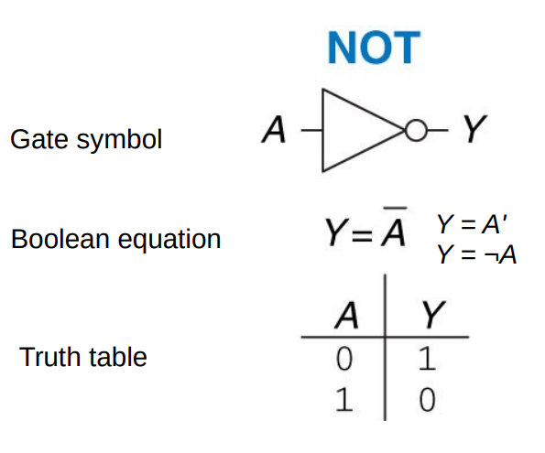
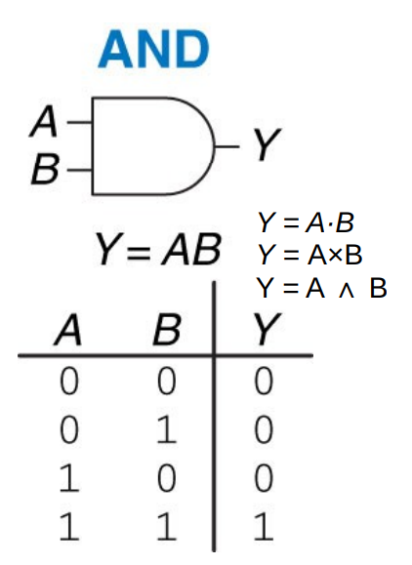
NOT & AND Gates

Slide 6
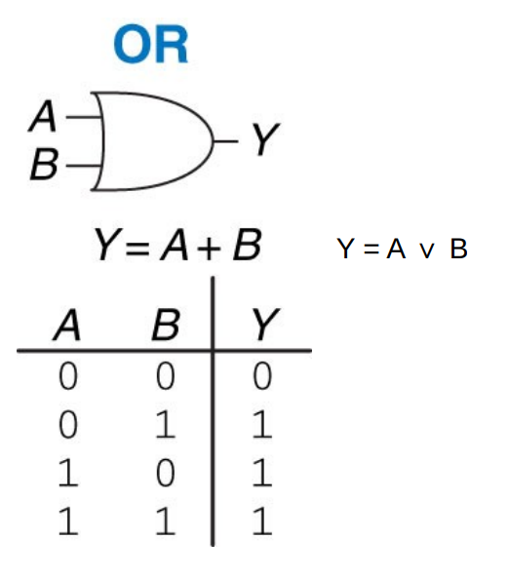
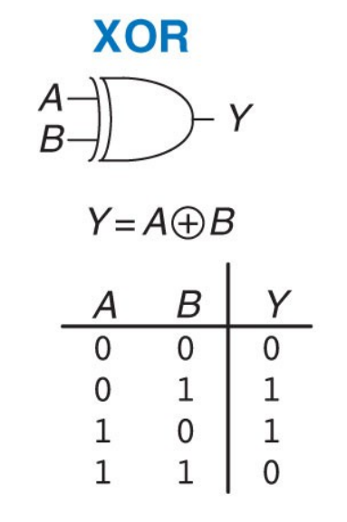
OR & XOR Gates

Slide 7
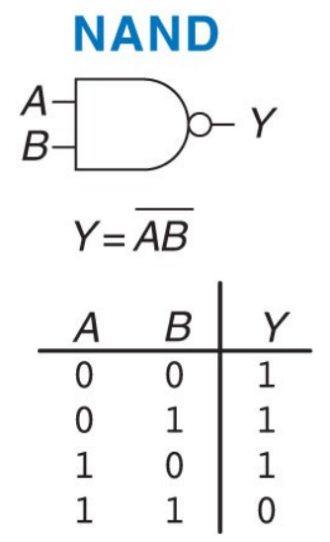
NAND Gates

Slide 8
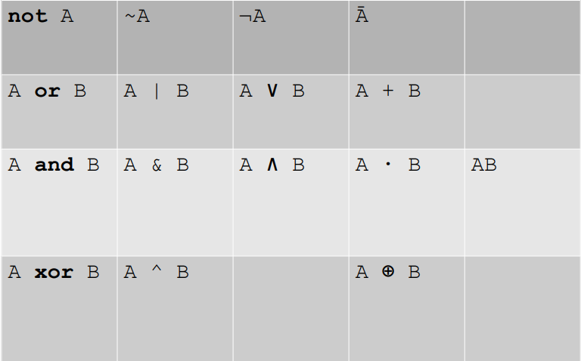
Algebraic Notation
01-intro-and-gates.pdf page 23

Slide 9
2’s Complement
A way to represent negative numbers
Must have fixed bit width
Conversion:
Flip all bits
Add 1
- [00101101 (45)] = 11010010 + 1 = 11010011 (-45)

